Slide 1


Machine Learning Data Platform Overview
Christopher K. Allen
Craig McChesney
Mitch Frauenheim

Slide 2

Topics
MLDP Overview
Survey of MLDP Elements
Project Status and Road Map
Summary

Slide 3
MLDP Overview Motivation
Objective: To provide full-stack support for machine learning and general data science applications for the diagnosis, modeling, control, and optimization of large particle accelerator and experimental physics facilities.
Full stack: From high-speed data acquisition to rapid ML/AI application development and deployment.
MLDP gives data science perspective to archived facility data.

Slide 4
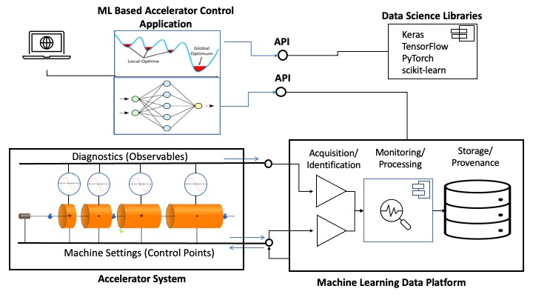
MLDP Overview Concept
The Machine Learning Data Platform (MLDP) has 4 primary functions:
High-speed data acquisition.
Managing archive of heterogeneous, time-correlated data.
Providing a variety of options for retrieving and manipulating data and metadata from the archive.
Capturing “value-added” information in the form of annotations to archive data.
These functions are realized by separate subsystems each supporting a category of use cases.
Conceptual diagram of Machine Learning Data Platform

Slide 5
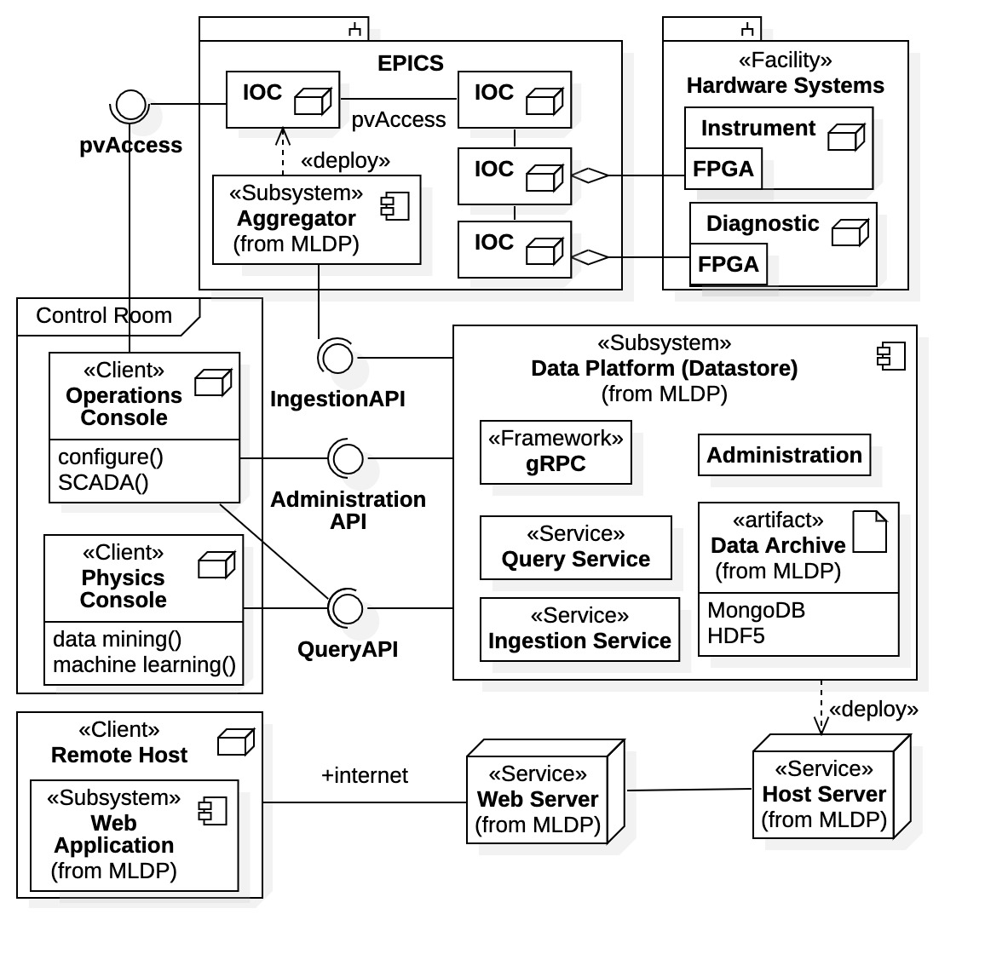
MLDP Overview Subsystems
Aggregator / Data Provider
High-speed data acquisition and collection of facility hardware data.
Interface between control system (e.g., EPICS) and MLDP data ingestion mechanism.
Core Services
Suite of collaborating services.
Primary MLDP interaction point for clients.
A standalone system that can be installed at any facility, independent of EPICS.
Well-defined APIs for communication.
Web Application
Exposes subset of Core Services features via browser app.
Machine Learning Data Platform subsystems and deployment

Slide 6
Topics
MLDP Overview
Survey of MLDP Elements
Project Status and Road Map
Summary

Slide 7
Survey of MLDP Elements
MLDP System Architecture
Data Archive
Core Services
API
Applications
Web Application
Client Libraries

Slide 8
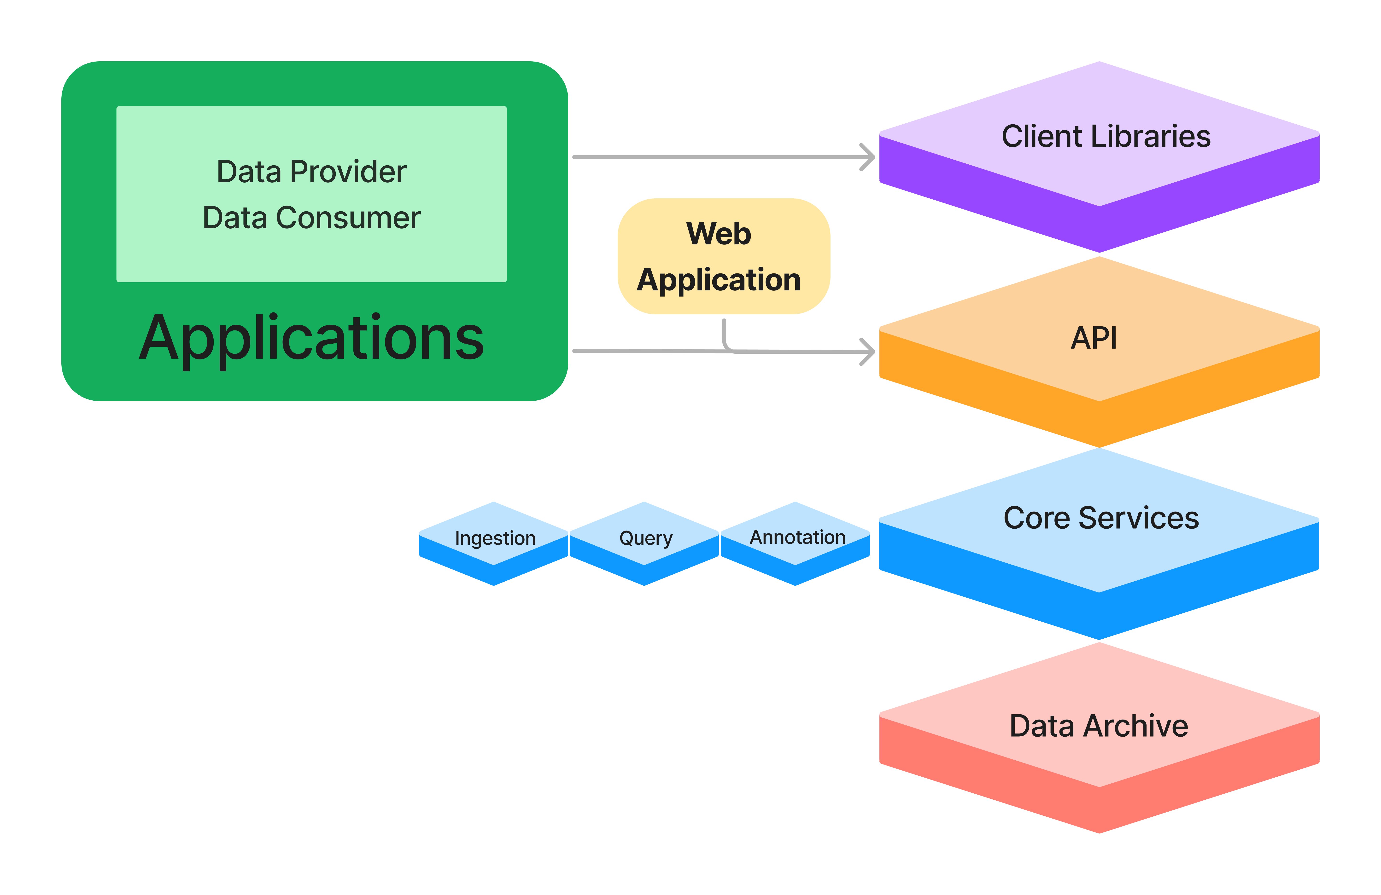
MLDP Elements System Architecture
Data Archive is used by Core Services to manage accelerator data.
Core Services handle ingestion, query, and annotation APIs.
API defines methods and data types for interacting with Core Services.
Java and Python Client Libraries are provided for higher-level interaction with Core Services.
Applications communicate with Core Services via API or Client Libraries..
Web Application provides browser access to Core Service features.

Slide 9
Survey of MLDP Elements
MLDP System Architecture
Data Archive
Core Services
API
Applications
Web Application
Client Libraries

Slide 10
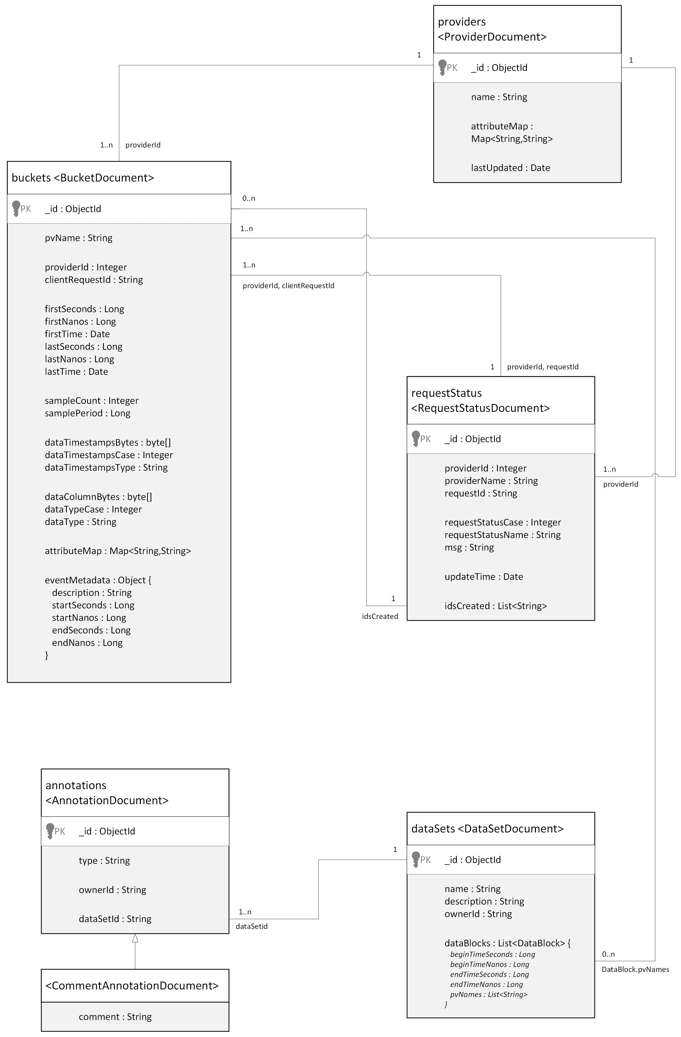
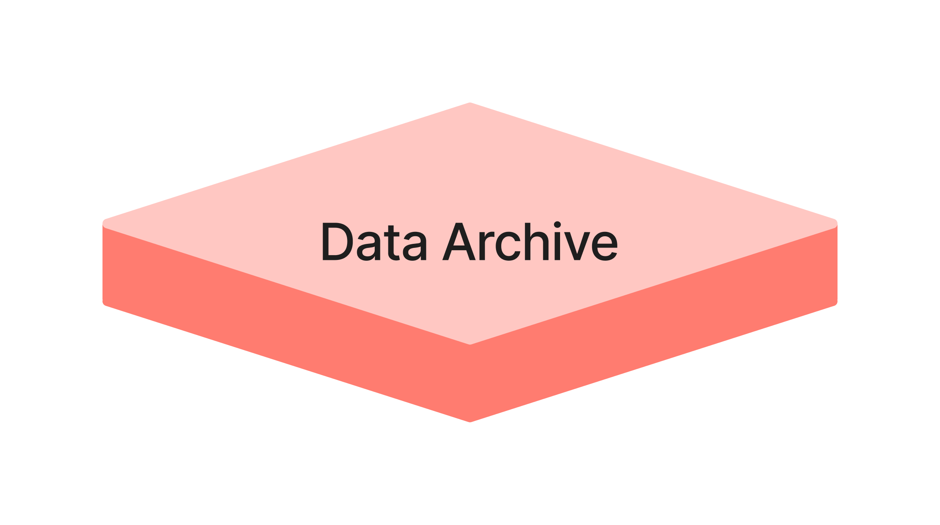
MLDP Elements Data Archive
The Core Services manage the Data Archive, which contains the following information:
Heterogenous, correlated, time-series device data.
Metadata describing characteristics of time-series data and its sources.
Annotations (notes, relations, calculations) made to datasets in the archive.
Provenance and relationships between datasets.
Status information used in monitoring to determine disposition of ingestion requests handled asynchronously.
This information is maintained as document collections in MongoDB.

Slide 11
Survey of MLDP Elements
MLDP System Architecture
Data Archive
Core Services
API
Applications
Web Application
Client Libraries

Slide 12
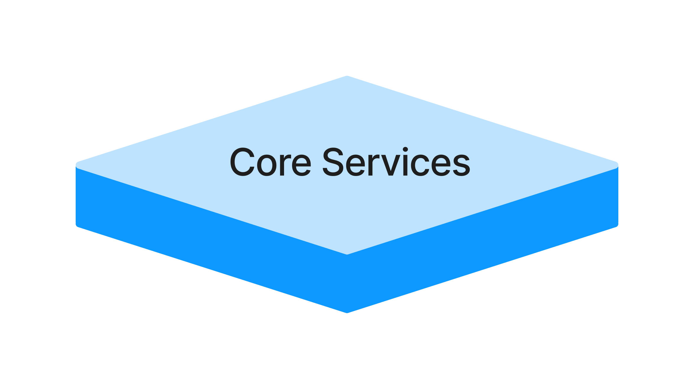
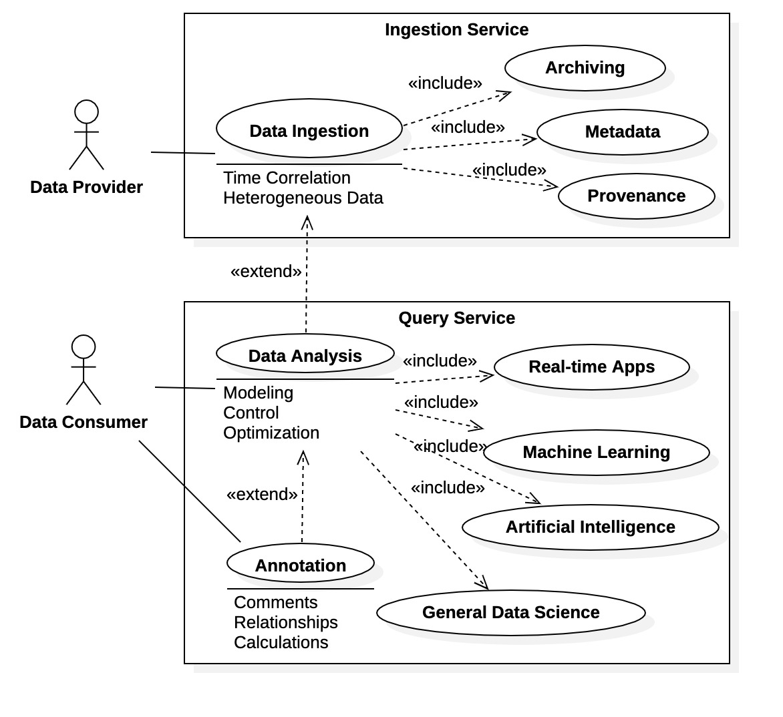
MLDP Elements Core Services – MLDP Service Model
The Core Services manage the Data Archive and are the primary interaction point for Provider and Consumer clients.
There are 3 MLDP services each providing an API covering a subset of the system use cases:
Ingestion Service is the focal point for capturing data to the Archive.
Query Service is the focal point for retrieving and processing time-series data and metadata from the Archive.
Annotation Service is the focal point for supplying ”value added” information to the Archive in the form of annotations.
Data Platform Use Cases

Slide 13
MLDP Elements Data Platform / Core Services Ingestion Service
The Ingestion Service provides APIs for registering data providers, ingesting data, and querying the status of ingestion requests.
Processing is asynchronous to maximize performance.
Writes time-series data “buckets” to MongoDB, each containing a vector of data values for a single PV over a time range.
Buckets store data values using serialized Protocol Buffer format.
Bucket time range is specified via start time, sample period, and number of samples (or explicit list of timestamps).
Sample Ingestion Service API methods
rpc registerProvider (RegisterProviderRequest) returns (RegisterProviderResponse);
rpc ingestDataStream (stream IngestDataRequest) returns (IngestDataStreamResponse);
rpc queryRequestStatus(QueryRequestStatusRequest) returns (QueryRequestStatusResponse);

Slide 14
MLDP Elements Data Platform / Core Services Query Service
The Query Service provides APIs for:
retrieving PV time-series data in bucketed or tabular format.
querying metadata about PV data sources and characteristics of time-series data.
Bucketed time-series data query response format contains data buckets matching query’s PV and time range criteria.
Each bucket contains a data vector for the specified PV over a specific time range.
Sample Query Service API methods
rpc queryDataStream(QueryDataRequest) returns (stream QueryDataResponse);
rpc queryTable(QueryTableRequest) returns (QueryTableResponse);
rpc queryMetadata(QueryMetadataRequest) returns (QueryMetadataResponse);

Slide 15
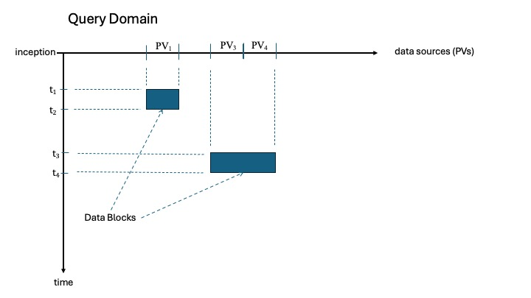
MLDP Elements Data Platform / Core Services Annotation Service
A Dataset is comprised of Data Blocks, each specifying PV(s) and time range.
The Annotation Service provides APIs for identifying “Datasets” in the archive, adding annotations to them, and performing queries.
A number of different types of annotations are supported (or planned), including basic descriptive information, links between related datasets, calculations, derived datasets, and provenance.
rpc createDataSet(CreateDataSetRequest) returns (CreateDataSetResponse);
rpc queryDataSets(QueryDataSetsRequest) returns (QueryDataSetsResponse);
rpc createAnnotation(CreateAnnotationRequest) returns (CreateAnnotationResponse);
rpc queryAnnotations(QueryAnnotationsRequest) returns (QueryAnnotationsResponse);

Slide 16
Survey of MLDP Elements
MLDP System Architecture
Data Archive
Core Services
API
Applications
Web Application
Client Libraries

Slide 17
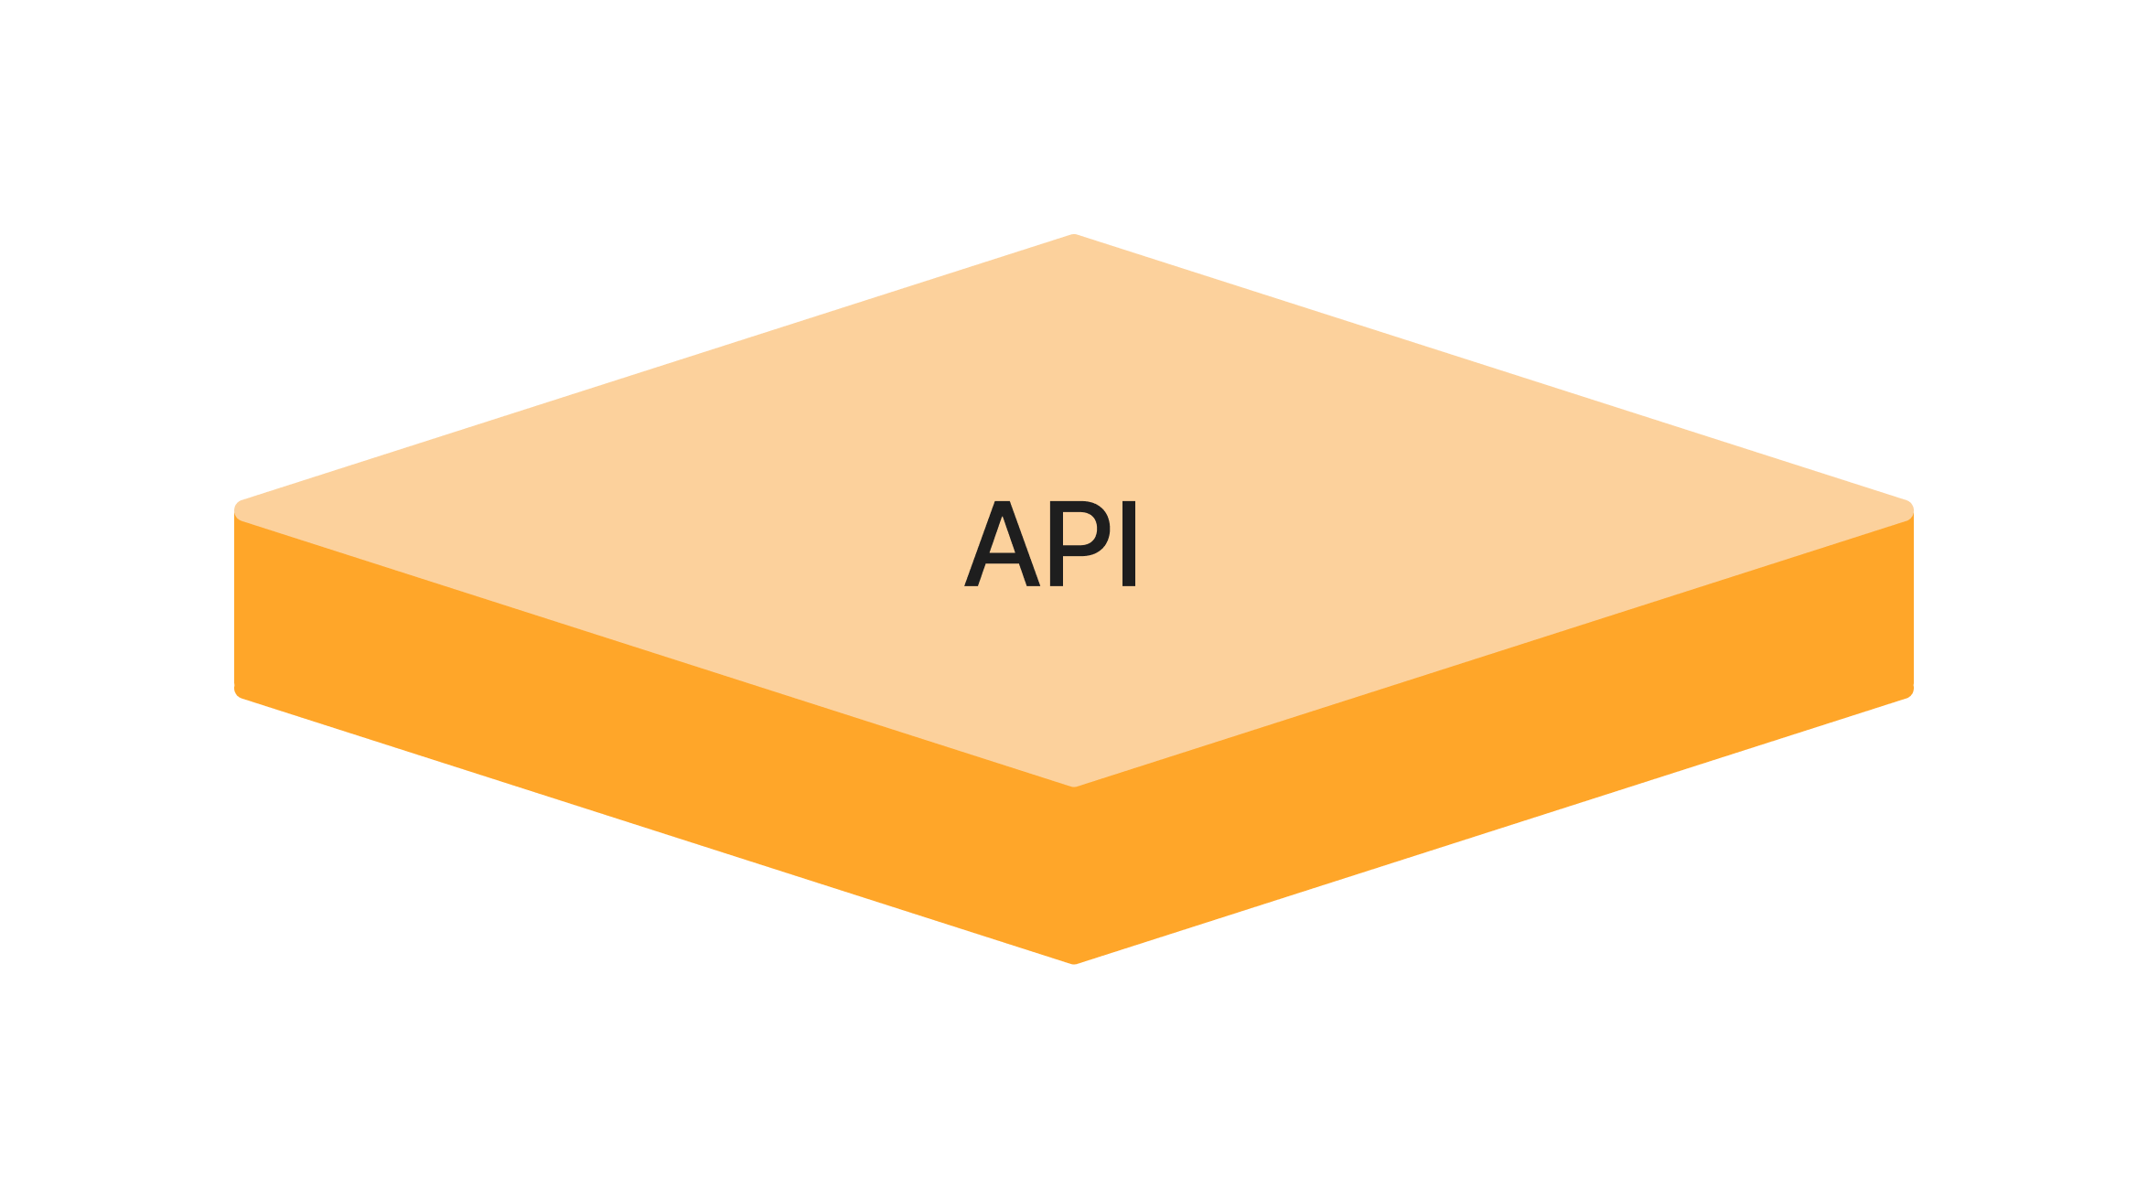
MLDP Elements API
The gRPC communication framework was originally developed by Google for use in connecting microservices.
It uses HTTP/2 for transport, and Protocol Buffers as both the interface definition language and message interchange format.
Supports simple unary single request / response APIs as well as unidirectional and bidirectional streaming.
We chose gRPC for the Data Platform API because it can meet our performance requirements for data ingestion, provides bindings for virtually any programming language, and supports a variety of application styles.

Slide 18
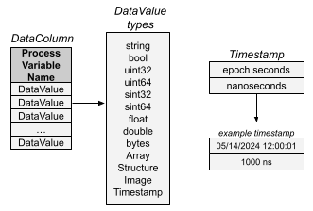
MLDP Elements API: Heterogeneous Data
The API defines type “DataValue” to represent a range of heterogeneous data types for use in the ingestion and query interfaces ranging from simple scalar data types to complex types including multi-dimensional arrays, structures, and images.
Each DataValue can optionally include “ValueStatus” information captured from the control system.
Times are represented using components for epoch second and nanoseconds (a third component could be added for finer resolution).

Slide 19
Survey of MLDP Elements
MLDP System Architecture
Data Archive
Core Services
API
Applications
Web Application
Client Libraries

Slide 20
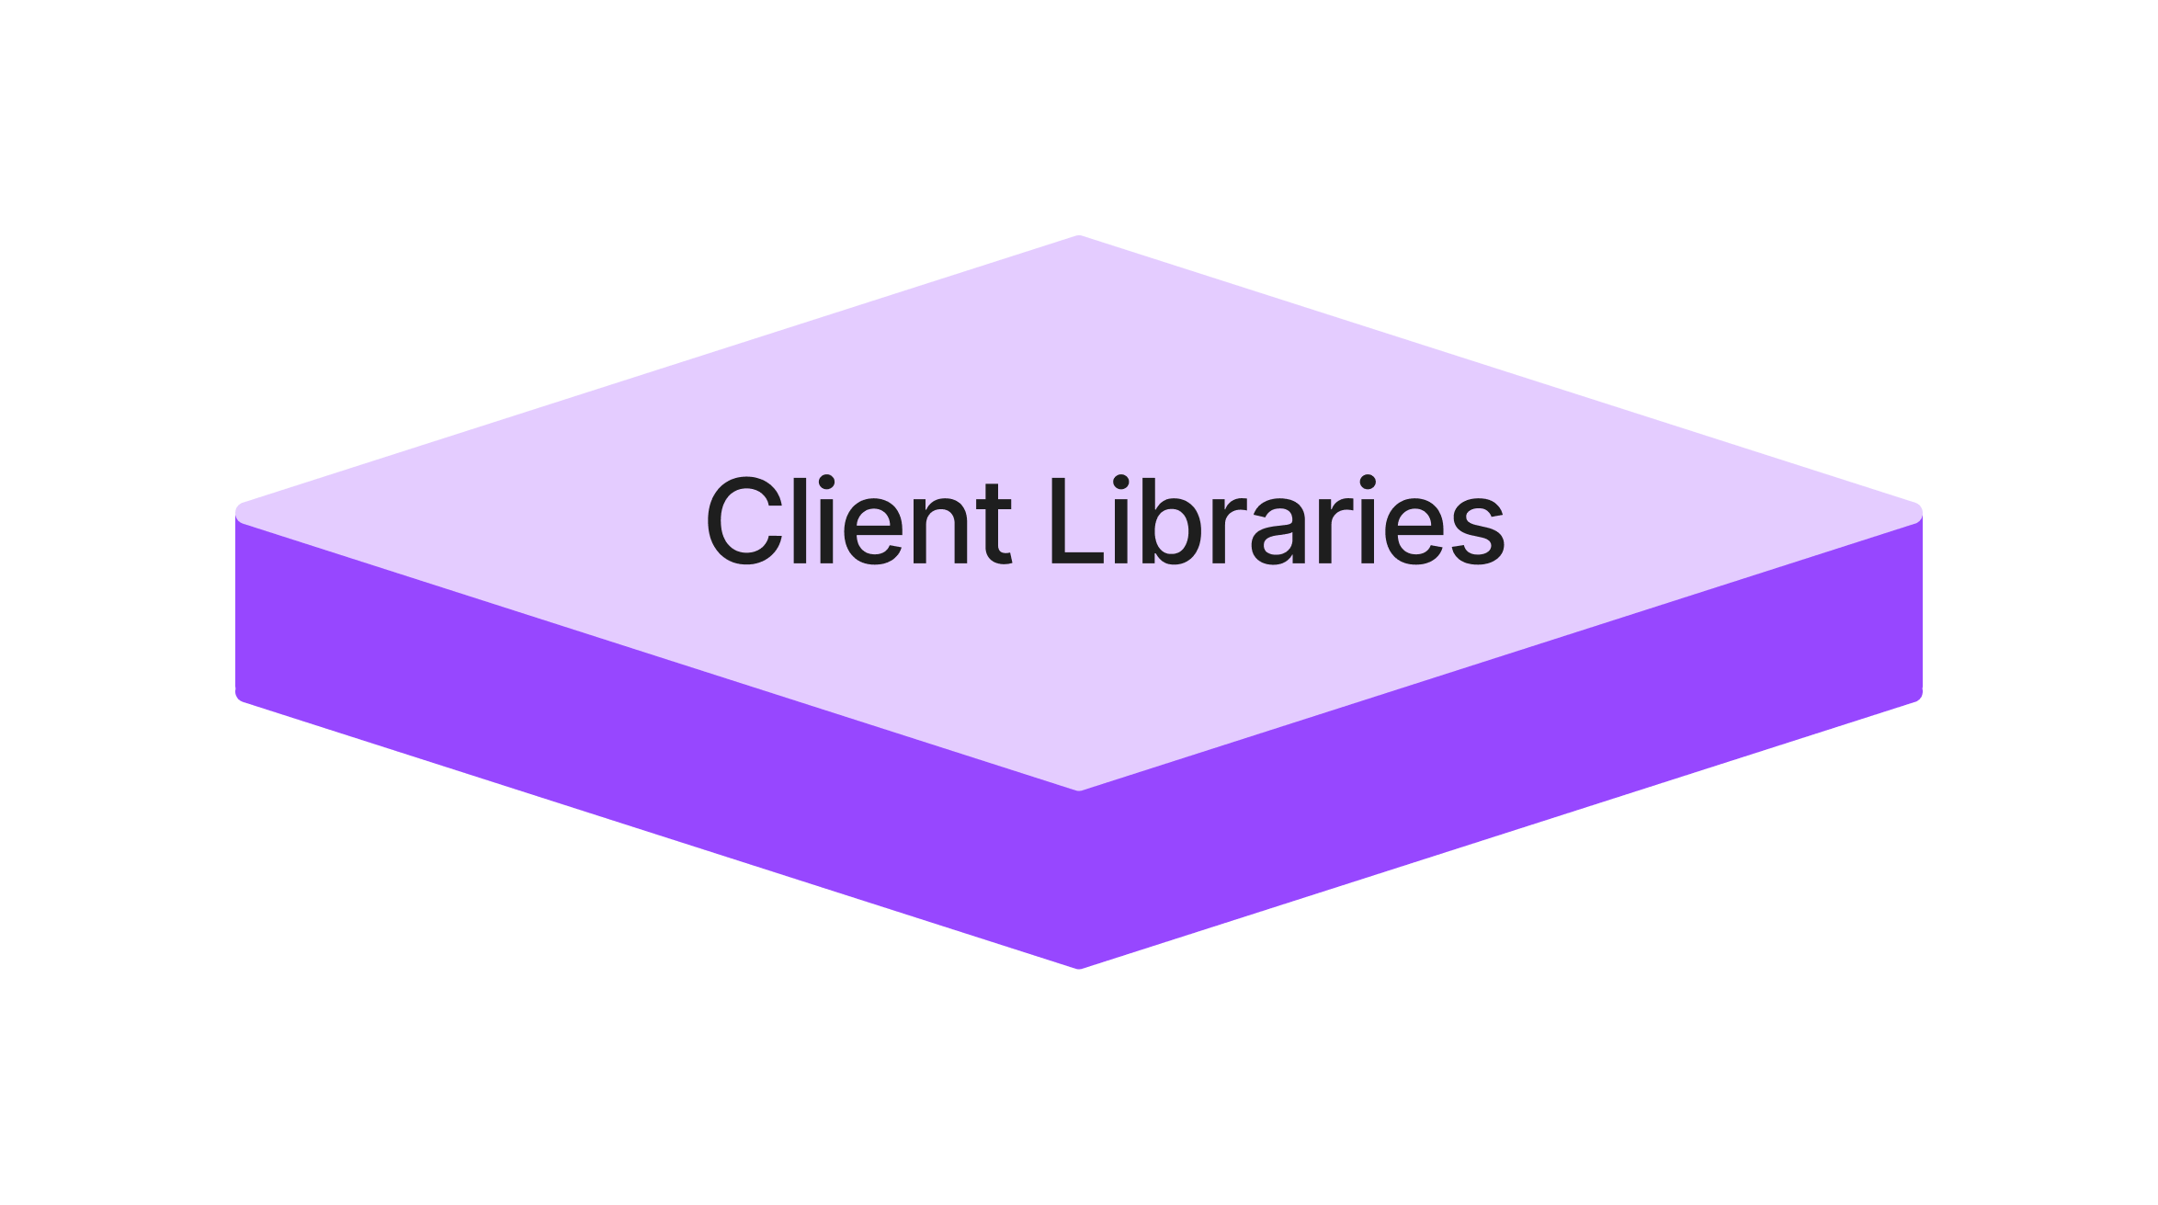
MLDP Elements Client Libraries
Client Libraries provide high-level tools for working with the MLDP service APIs, avoiding the complexities of direct gRPC communication. Libraries are currently under development for building client applications in Java and Python.
Example ingestion library features:
Utilities for working with EPICS normative times and pvAccess interface.
Breaking a large dataset into manageable chunks for ingestion.
Example retrieval and processing library features:
Subscribing to time-series data for specified PVs with updates at specified time interval.
Maintaining data for a set of PVs over a rolling window of time.
Assembling bucketed time-series data from the query response to a dynamic tabular structure.
Packaging results for use with common 3rd party packages like Pandas and numpy.

Slide 21
Survey of MLDP Elements
MLDP System Architecture
Data Archive
Core Services
API
Applications
Web Application
Client Libraries

Slide 22
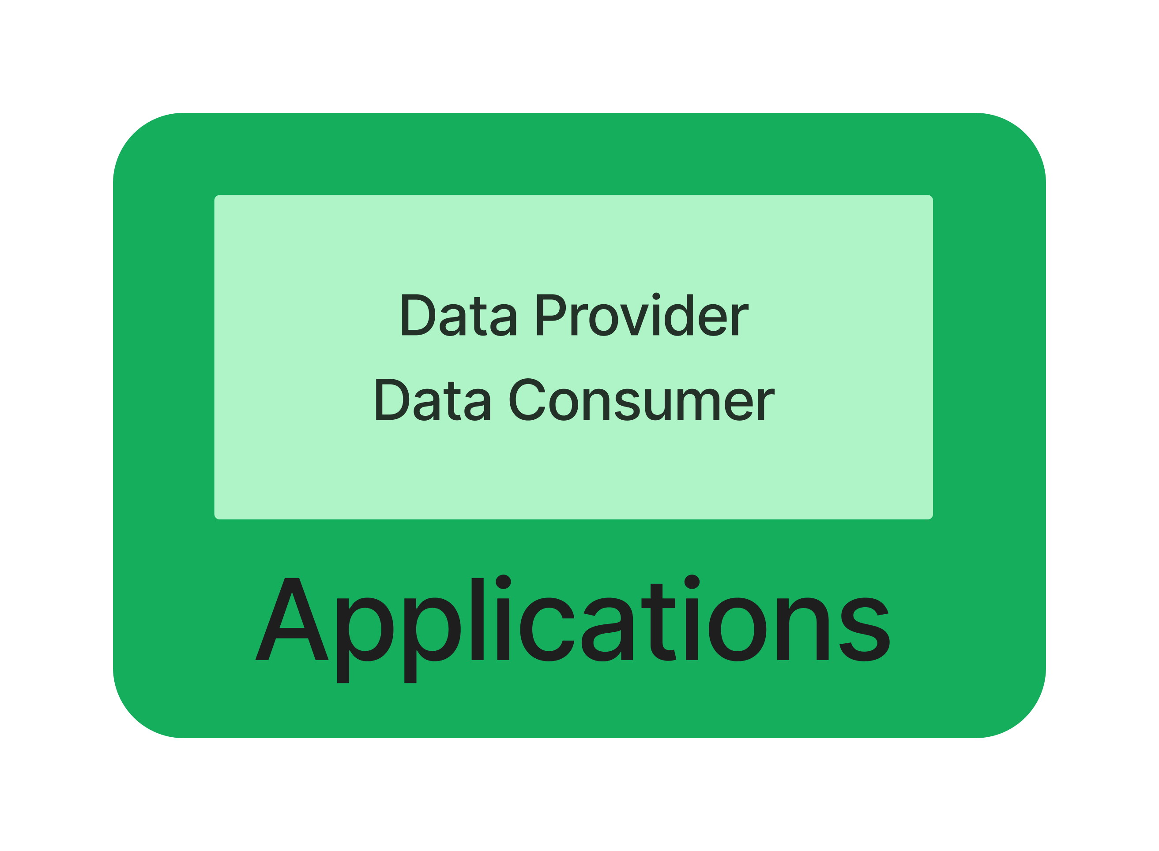
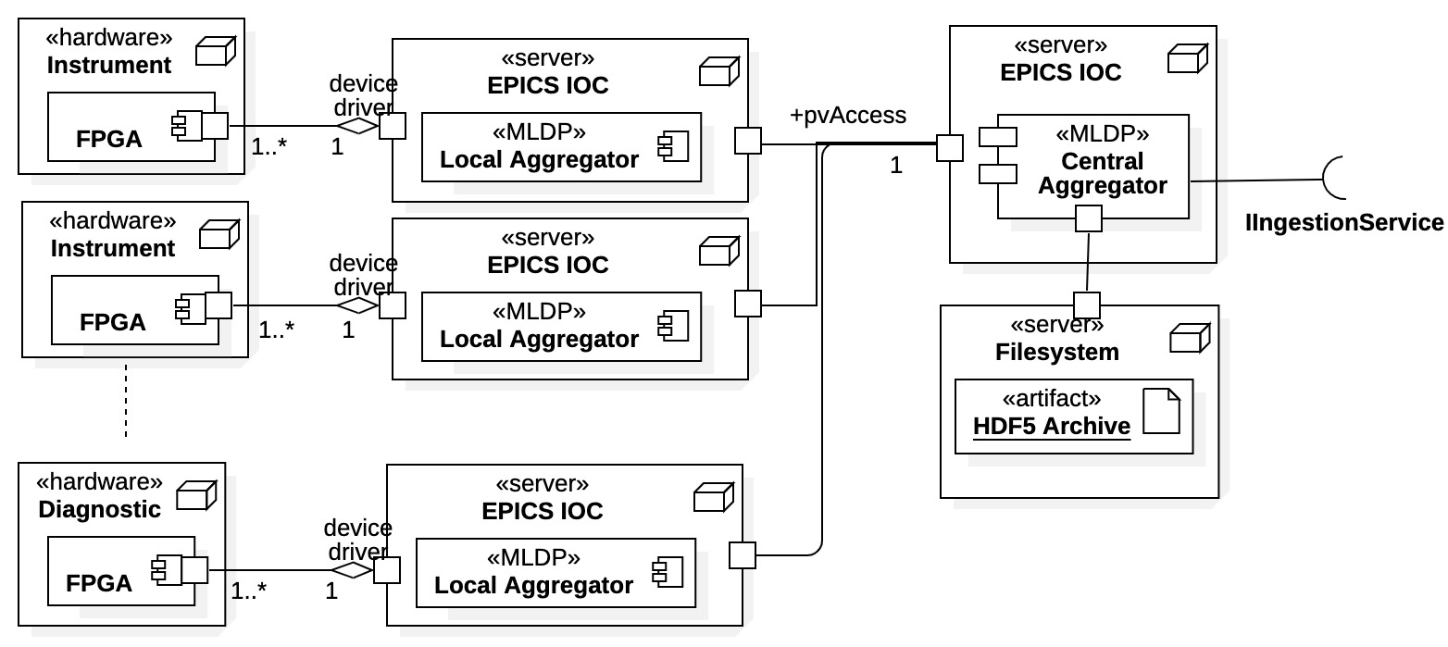
MLDP Elements Applications: Aggregator / Data Provider
Aggregator / Data Provider is an application that interfaces the EPICS control system to the MLDP Ingestion Service, performing high-speed device data acquisition and collection.
The Aggregator System Architecture includes Local and Central Aggregators.
Local Aggregators
Proximal to hardware.
Collect and align local hetero data.
May have multiple data sources.
Transport to Central Aggregator.
Central Aggregator
Coalesce all aggregated data.
Stage as NTTable formatted snapshots.
Transport to MLDP Ingestion Service.
Aggregator System Architecture

Slide 23
MLDP Elements Applications: Example gRPC Client Application
// Create gRPC request message.
IngestionRequest.Builder requestBuilder = IngestionRequest.newBuilder();
// Set event timestamp in request.
Timestamp.Builder snapshotTimestampBuilder = Timestamp.newBuilder();
snapshotTimestampBuilder.setEpochSeconds(params.snapshotTimestampSeconds);
snapshotTimestampBuilder.setNanoseconds(params.snapshotTimestampNanos);
snapshotTimestampBuilder.build();
requestBuilder.setSnapshotTimestamp(snapshotTimestampBuilder);
// Set data in request.
IngestionDataFrame dataFrame = ingestionDataFrameForTable(pvDataTable);
requestBuilder.setIngestionDataFrame(dataFrame);
// Build and send request.
IngestionResponse = blockingStub.ingestData(requestBuilder.build());
The low-level gRPC Ingestion and Query Service APIs can be used from a wide variety of programming languages to build applications.
Example: Create ingestion request, set timestamp and add data, build and send request.

Slide 24
MLDP Elements Applications: Example Client Library Application
// Create interface to streaming ingestion service.
IIngestionStream ingStream = DsIngestionServiceFactory.connectStream();
// Open stream for PV data provider registration.
ingStream.openStream(pvProviderRegistration);
// Create DataFrame from PV table for current interval.
DataFrame dataFrameCurrentInterval = DataFrame.from(pvValueTable);
// Send data frame to ingestion service in current stream.
ingStream.streamData(dataFrameCurrentInterval);
Use of Client Libraries provides higher-level interface for building applications.
Example: Open streaming connection to Ingestion Service, create data frame for current interval, send to service.

Slide 25
Survey of MLDP Elements
MLDP System Architecture
Data Archive
Core Services
API
Applications
Web Application
Client Libraries

Slide 26
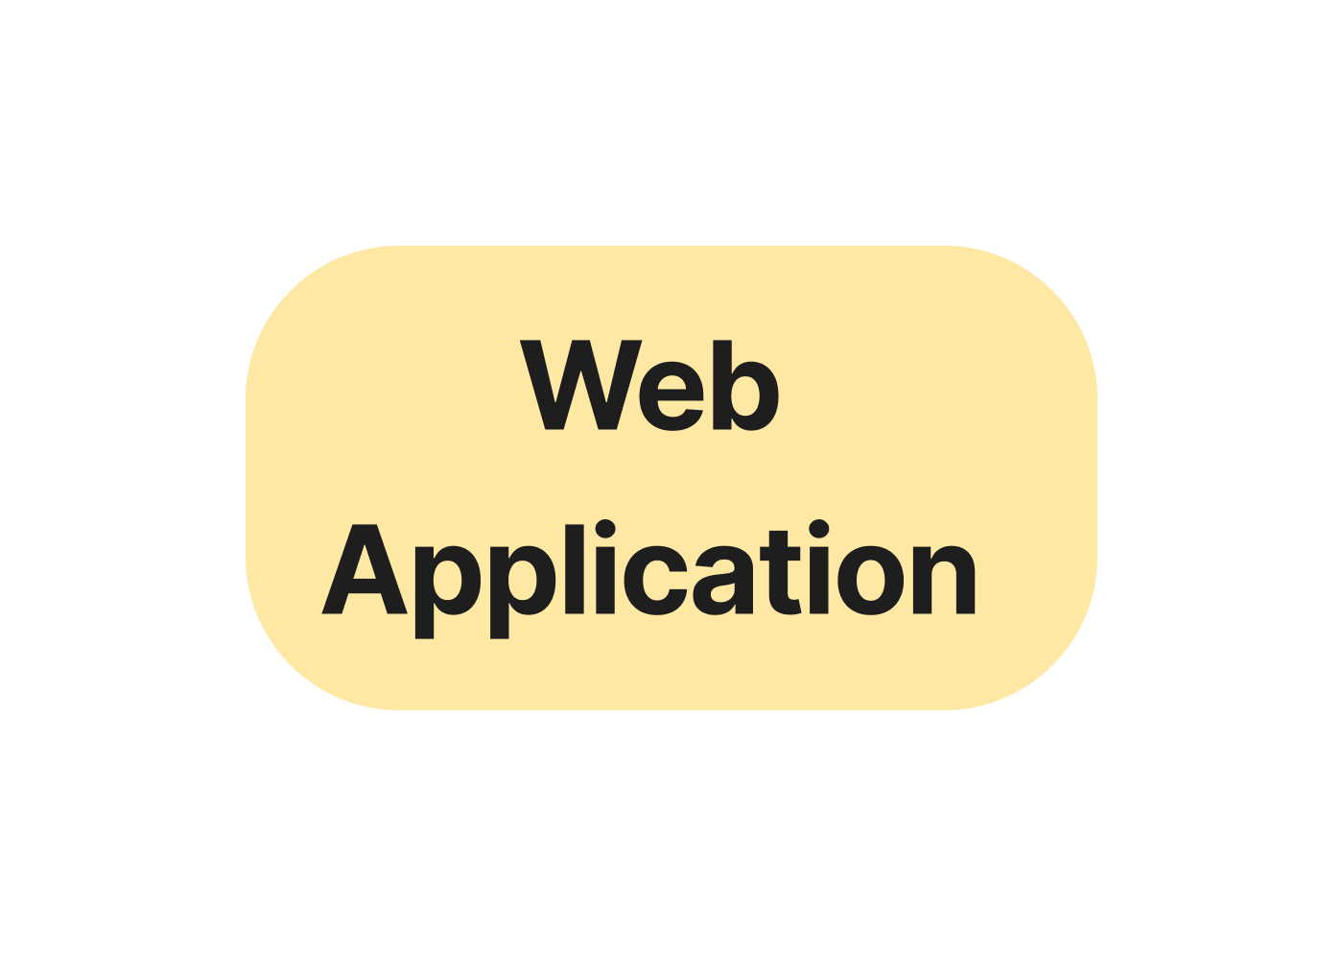
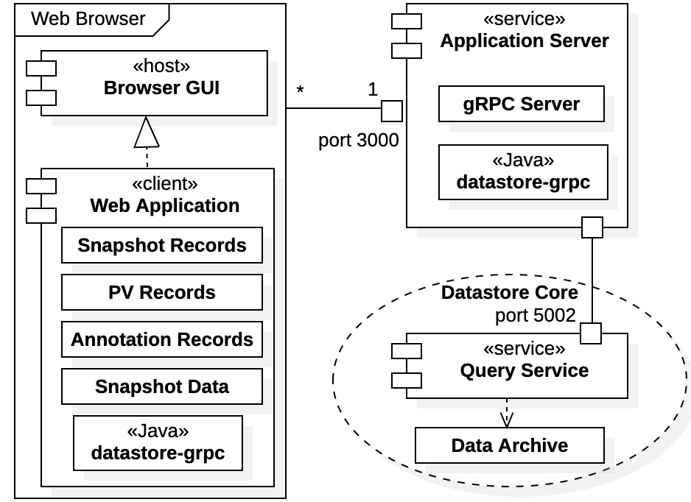
MLDP Elements Web Application
MLDP Web Application is a browser-based application built using JavaScript.
Provides remote access to the MLDP Core Services:
Facilitates a subset of Query and Annotation Service features.
Provides tools for navigation, inspection, visualization, download, and data processing / analysis.
Web Application Server provides an API that augments the core Data Platform API.
Web Application Architecture

Slide 27
Topics
MLDP Overview
Survey of MLDP Elements
Project Status and Road Map
Summary

Slide 28

MLDP Project Status
Fully implemented Core Service APIs:
Ingestion: provider registration, ingestion of time-series data, querying status of async ingestion requests.
Query: querying time-series data in bucketed and tabular format, querying Data Archive metadata.
Annotation: Identifying datasets within the Archive, adding annotations to them, querying annotations and retrieving dataset time-series data
Eliminated many 3rd party dependencies from original prototype – now restricted to Java, gRPC, and MongoDB.
Created suite of utilities for managing MLDP ecosystem.
Created deployment tools and “quick start” installer.
Ingestion over 200x faster than prototype at ~ 200 MBps data ingestion rates.
Evaluated C++ gRPC for datastream processing (~ 500 MBps transmission rates).

Slide 29
MLDP Road Map
Continue adding features to Core Services:
Ingestion: Framework for measuring data ingestion statistics.
Annotation: Export mechanism, additional annotation types.
Continue development of Client Libraries.
Perform more extensive load and scale testing.
Build data generator / simulator.
Add mechanism for customizable, real-time processing of ingestion data stream.
Incorporate authentication and authorization:
Token based authentication for query clients and web application.
Role-based authorization.
Create infrastructure for system administration:
Age-based archival of data to HDF5 files to manage database footprint.
Tools for replication / synchronization of archive to distributed researchers.
Investigate approaches for performance improvement:
MongoDB clustering, partitioning (sharding), and connection pooling.
Horizontal scaling for deployment of core services.
Optimized tools for data streaming between components e.g., Apache Kafka

Slide 30
Topics
MLDP Overview
Survey of MLDP Elements
Project Status and Road Map
Summary

Slide 31
Summary
The Core Services are the foundation of the MLDP.
This collaborating suite of services manages an archive of heterogenous data with a focus on data science applications.
Each service offers a well-defined API.
The initial APIs for the Ingestion, Query, and Annotation services are defined, implemented and fully functional – and will continue to evolve.
The MLDP offers two modes of communication, supporting a wide range of application types and programming styles.
Direct gRPC API communications is supported for most programming languages.
Client Libraries are provided for Java and Python applications.
APIs support both simple request-response interaction and sophisticated bidirectional streaming.
Ingestion performance is a key consideration and primary focus.
The current MLDP implementation exceeds the baseline performance objective initially established for the project, and continuous improvements are expected.

Slide 32

Supplemental

Slide 33
Supplemental Material
SBIR Project Background
Ingestion Data Flow Diagram
Bucket Pattern for Time-Series Data
DP Deployment
Example Data Flow
Why use an API?
Authentication / Authorization
Performance Benchmarks

Slide 34
MLDP Overview SBIR Project Background
MLDP development is supported by the US Dept. of Energy (DOE) under a Small Business Innovative Research (SBIR) grant starting in 2022.
A prototype MLDP was completed in Phase I with the following subsystems:
Aggregator – EPICS based, high-speed synchronous data acquisition of heterogeneous data.
Datastore – Standalone system for data ingestion, archive management and access.
Web Application – Universal, remote access and interaction with data archive.
SBIR Phase II awarded in 2023 (Fiscal Year 2024)
Redesign of Datastore archive and services with emphasis on performance (Year 1).
Support for full archive annotation (Year 1).
Datastore use case expansions (Year 2)
Datastream processing,
Algorithm Plugins,
Advanced Data Science Applications.
“Data Platform” (DP) references previous “Datastore” system of prototype MLDP.
Includes upgrades and extensions for Phase II project.

Slide 35
Supplemental Material
SBIR Project Background
Ingestion Data Flow Diagram
Bucket Pattern for Time-Series Data
DP Deployment
Example Data Flow
Why use an API?
Authentication / Authorization
Performance Benchmarks

Slide 36
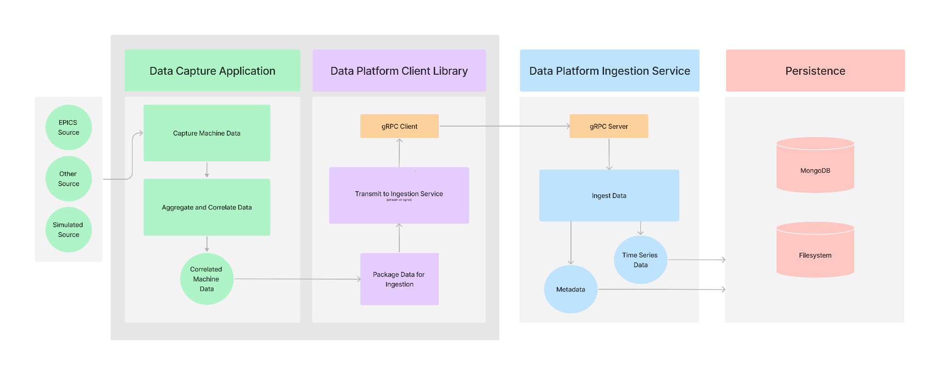
MLDP Elements Ingestion Data Flow Diagram

Slide 37
Supplemental Material
SBIR Project Background
Ingestion Data Flow Diagram
Bucket Pattern for Time-Series Data
DP Deployment
Example Data Flow
Why use an API?
Authentication / Authorization
Performance Benchmarks

Slide 38
MLDP Elements Data Platform / Core Services Ingestion Service: Bucket Pattern for Time-Series Data
Simple example with 3 measurements, each stored as an individual database record:
{ sensor_id: 12345, timestamp: ISODate("2019-01-31T10:00:00.000Z"), temperature: 40 }
{ sensor_id: 12345, timestamp: ISODate("2019-01-31T10:01:00.000Z"), temperature: 40 }
{ sensor_id: 12345, timestamp: ISODate("2019-01-31T10:02:00.000Z"), temperature: 41 }
Same 3 measurements stored in a single data bucket record, saving the overhead of sensor_id and timestamp for each measurement:
{ sensor_id: 12345,
start_date: ISODate("2019-01-31T10:00:00.000Z"),
sample_period_nanos: 1_000_000_000,
count: 3
measurements: [ 40, 40, 41 ] }

Slide 39
Supplemental Material
SBIR Project Background
Ingestion Data Flow Diagram
Bucket Pattern for Time-Series Data
DP Deployment
Example Data Flow
Why use an API?
Authentication / Authorization
Performance Benchmarks

Slide 40
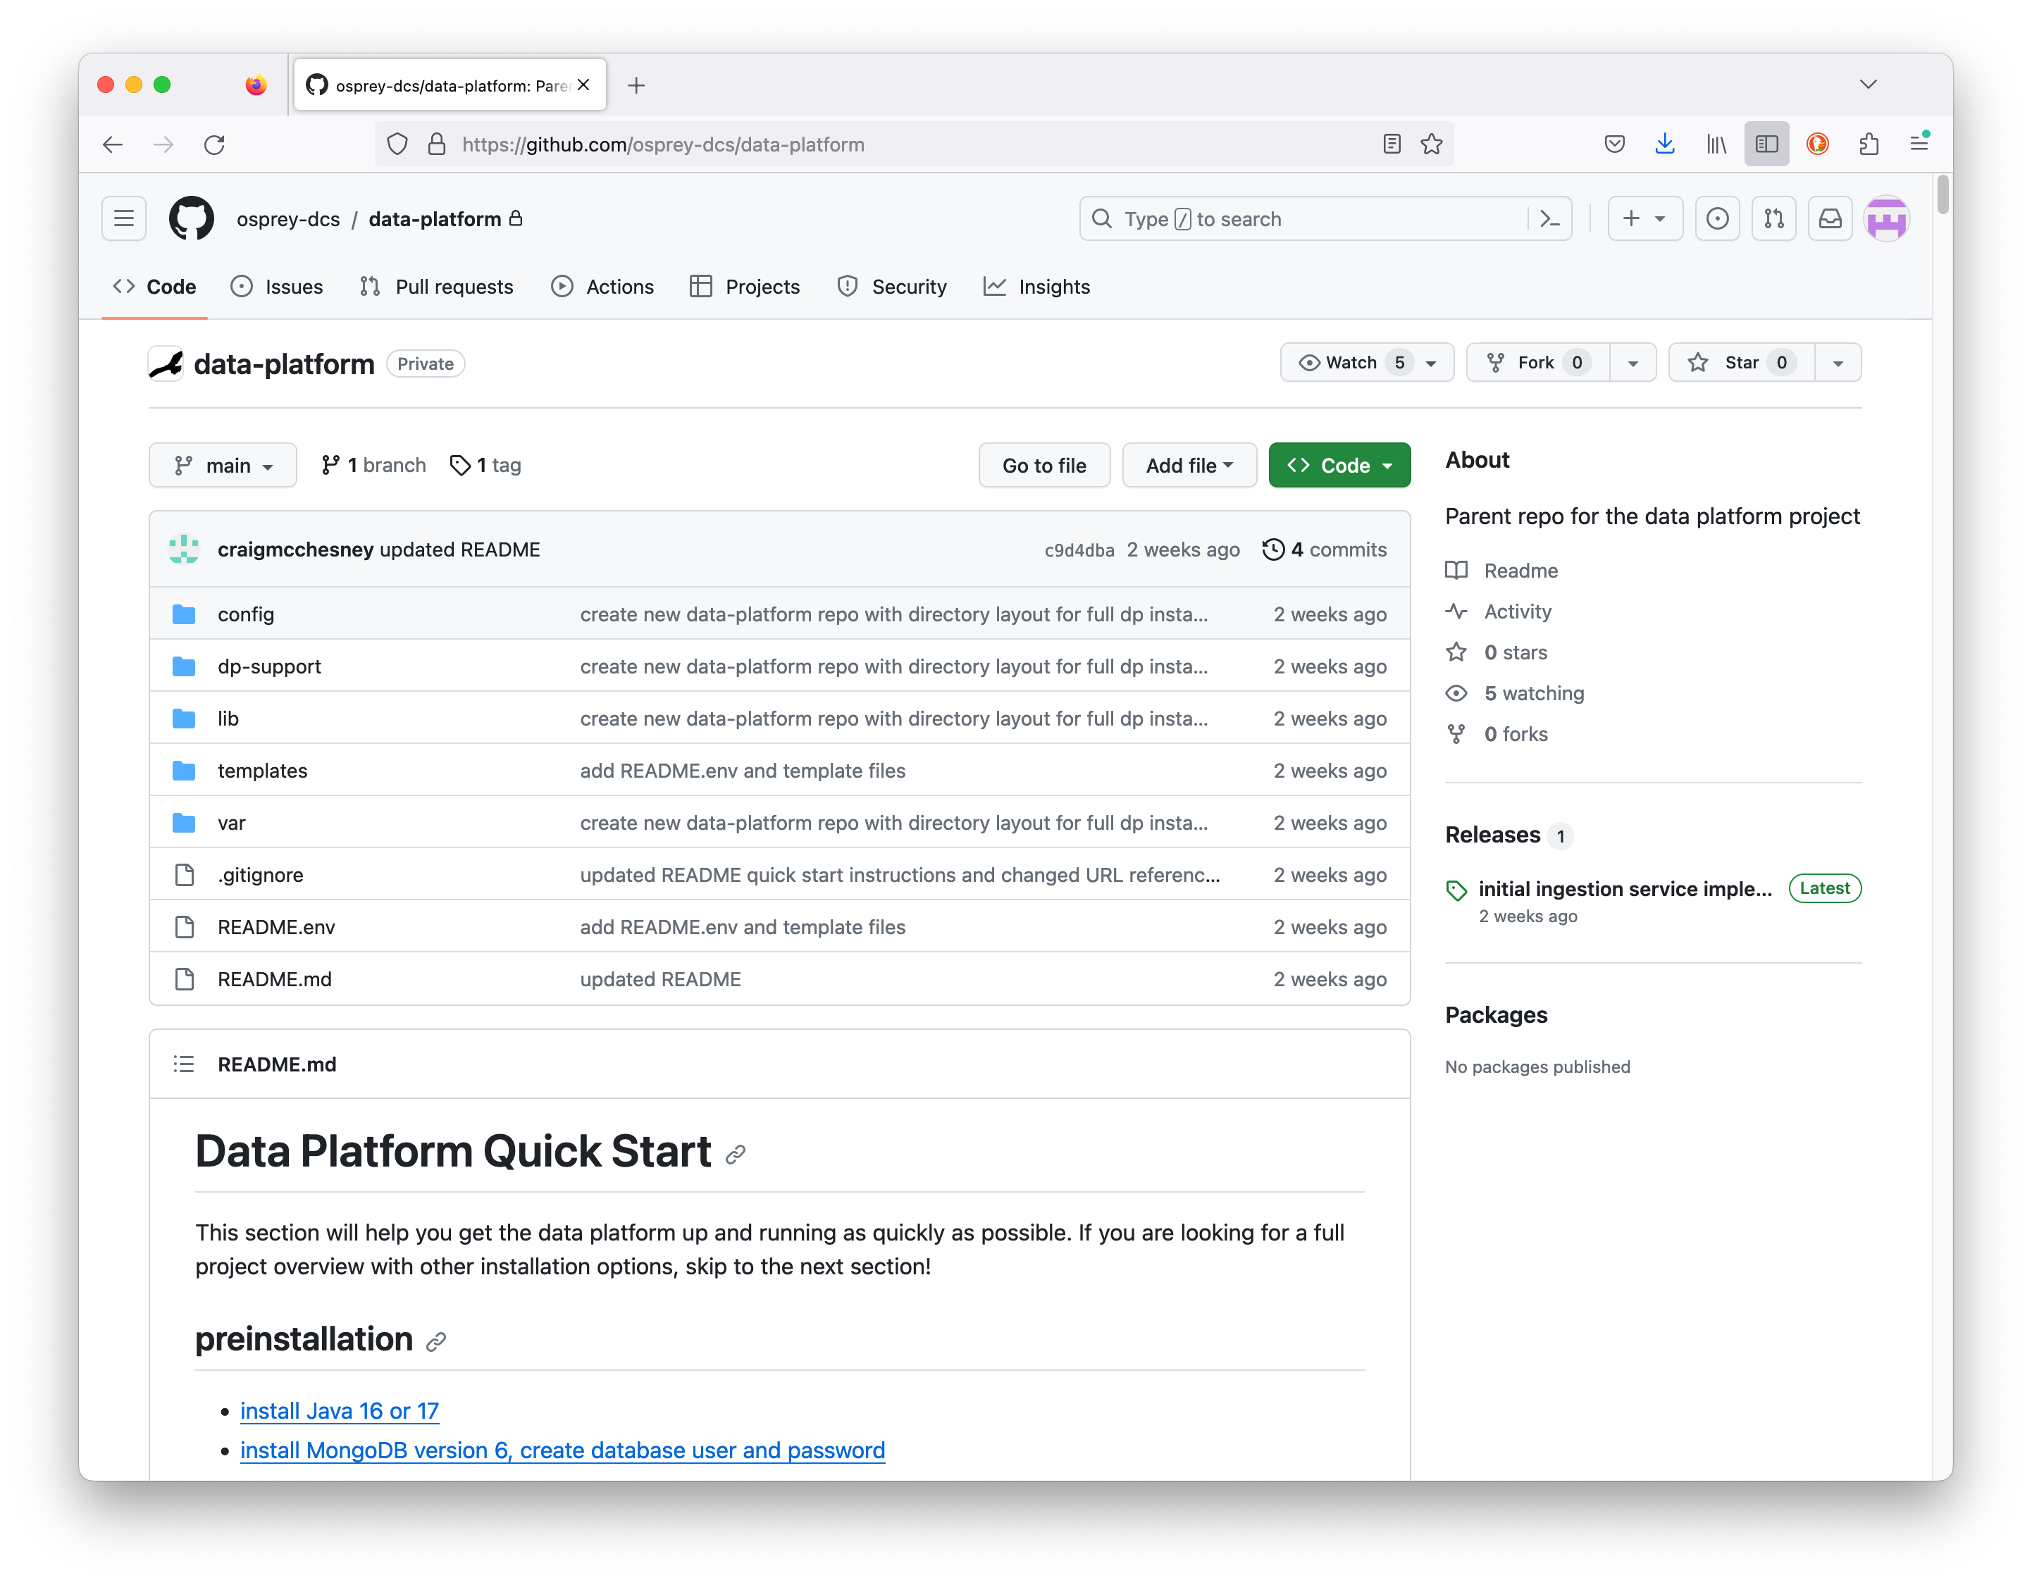
DP Deployment Installation Repository
https://github.com/osprey-dcs/data-platform
Installation distributed as a zipped archive.
Download and unzip into local installation directory.
Services deployed as Java “fat jars”.
Services are started with scripts.
located in expanded dp-support directory.
Process is well documented.
See Github repository page.
Instructions/documentation
data-platform-installer.tar.gz - Download and unzip.

Slide 41
Supplemental Material
SBIR Project Background
Ingestion Data Flow Diagram
Bucket Pattern for Time-Series Data
DP Deployment
Example Data Flow
Aggregator
Provider
Ingestion Service
Query Service
Annotation Service
Why use an API?
Authentication / Authorization
Performance Benchmarks

Slide 42
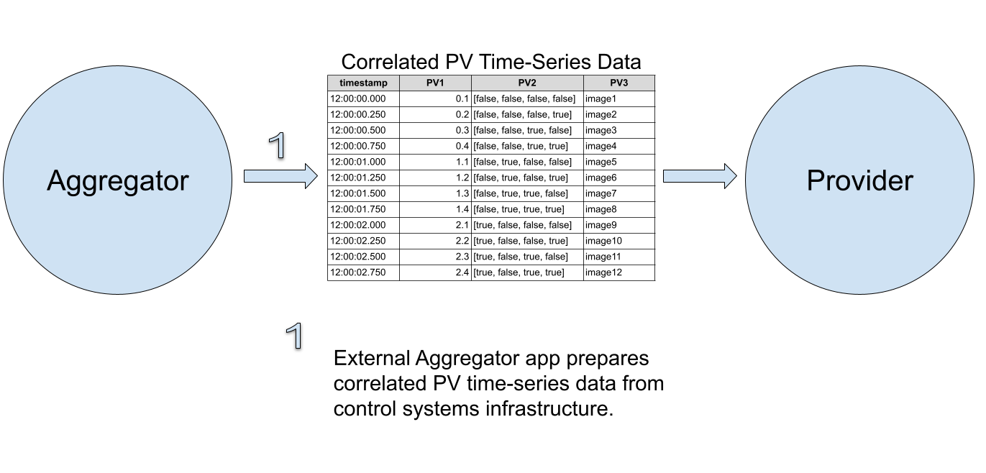
Example Data Flow Aggregator -> Provider

Slide 43
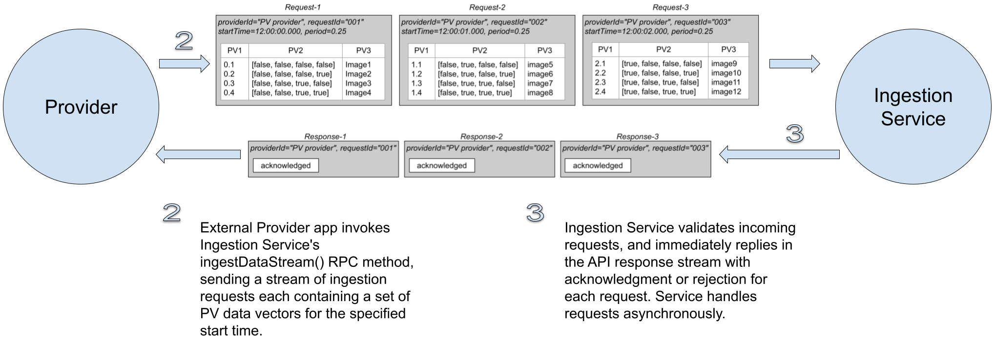
Example Data Flow Provider -> Ingestion Service

Slide 44
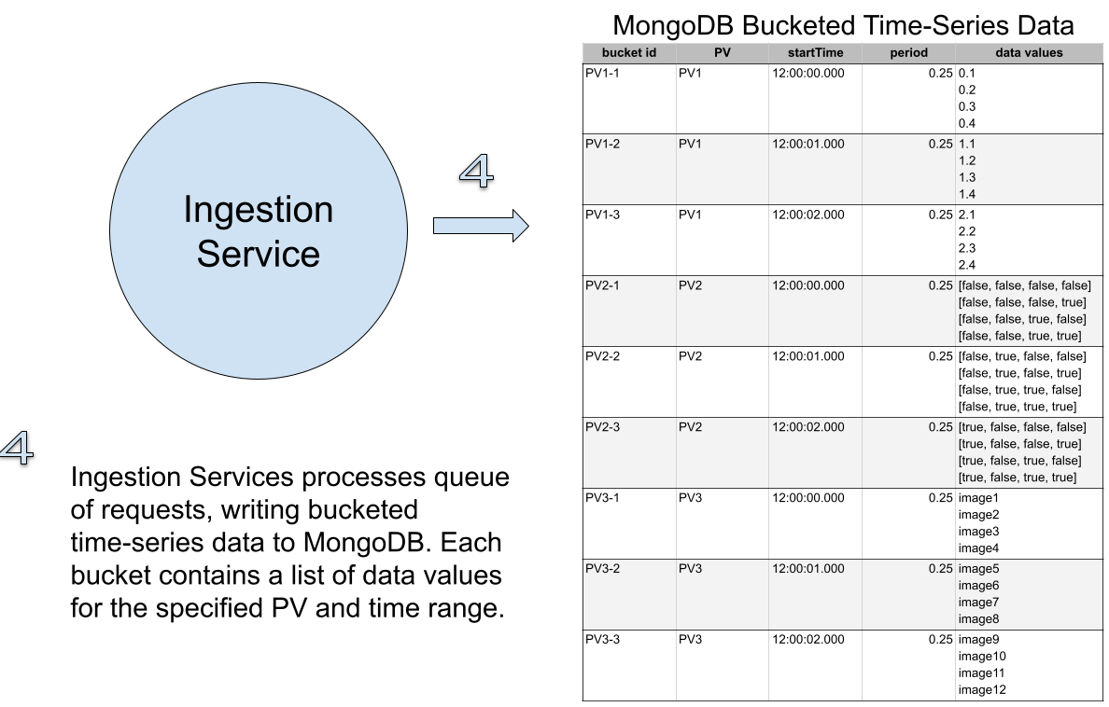
Example Data Flow Ingestion Service -> MongoDB

Slide 45
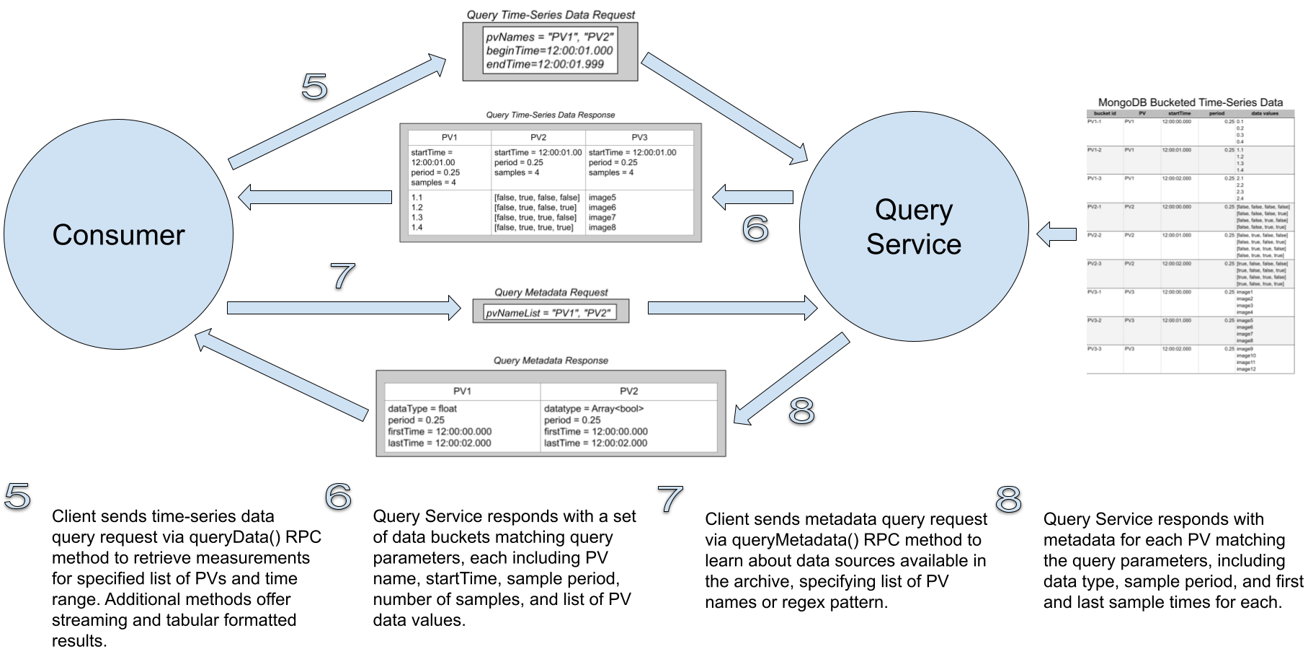
Example Data Flow Consumer -> Query Service

Slide 46
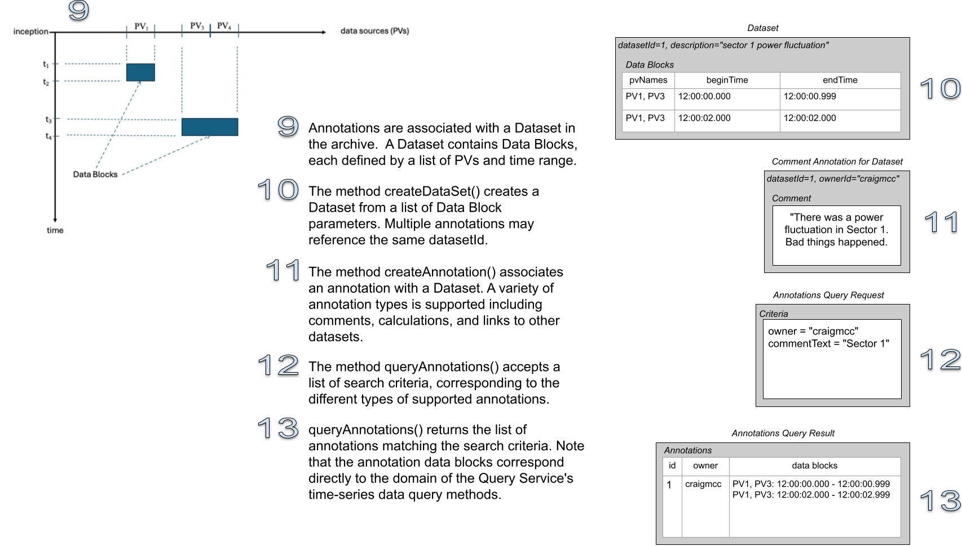
Example Data Flow Consumer -> Annotation Service

Slide 47
Supplemental Material
SBIR Project Background
Ingestion Data Flow Diagram
Bucket Pattern for Time-Series Data
DP Deployment
Example Data Flow
Why use an API?
Authentication / Authorization
Performance Benchmarks

Slide 48
Why use an ingestion service API instead of writing directly to the database?
This is a common question and is understandable when the focus is on ingestion performance. Using a service API facilitates:
Changing the underlying persistence technology or database schema transparently to the clients
Capturing data from a wide variety of devices without creating a custom capture client for each of them that exposes the details of the underlying persistence mechanism and must be kept in sync with database/schema changes
The performance measured for the initial ingestion service implementation is in the same range as our benchmark for writing data directly to MongoDB, so using the service API doesn't seem to degrade performance significantly.

Slide 49
Supplemental Material
SBIR Project Background
Ingestion Data Flow Diagram
Bucket Pattern for Time-Series Data
DP Deployment
Example Data Flow
Why use an API?
Authentication / Authorization
Performance Benchmarks

Slide 50
Authentication / Authorization
Assumption is that ingestion clients run behind firewall and that authentication is not required (e.g., similar to EPICS infrastructure components). Authentication is required for query clients. Initial thoughts about how we will handle authentication and authorization in the gRPC service:
Enable server authentication and secure transport via built in gRPC support for SSL/TLS.
Create a new "login" gRPC API method in the ingestion (and query) services. The login method will use the infrastructure LDAP service to authenticate the user credentials. It will return a JSON web token (JWT) to the caller.
In subsequent gRPC API calls, the client will attach the JWT token as metadata to the request header.
Investigate use of API token authentication for infrastructure applications (not tied to a specific user).

Slide 51
Supplemental Material
SBIR Project Background
Ingestion Data Flow Diagram
Bucket Pattern for Time-Series Data
DP Deployment
Example Data Flow
Why use an API?
Authentication / Authorization
Performance Benchmarks

Slide 52
Project Status Performance Benchmarks
Benchmark Description | Data Rates
 | Double Values (vals/sec) | Bytes (bytes/sec)
gRPC network transmission (Java) | 22M – 33M | 176M – 264M
Archiving, structured - HDF5 large | 68M – 77M | 544M – 616M
Archiving, structured - JSON files | 38M – 47M | 304M – 376M
Archiving, buckets - MongoDB | 7M – 11M | 56M – 88M
Archiving, buckets - MariaDB | 4.5M – 5.5M | 36M – 44M
Archiving, structured - HDF5 small | 1.3M – 2.4M | 10.4M – 19.2M
Archiving, points - InfluxDB | 750K – 940K | 6M – 7.52M
Archiving, points - MongoDB | 360K – 410K | 2.88M – 3.28M
Archiving, points - MariaDB | 140K – 162K | 1.12M – 1.3M
Metadata updates - MongoDB | 11K to 36K updates/sec | -
Redesign of Data Platform required extensive testing and benchmarking of existing technologies and methods.
Performance
Modularity/dependencies
Development effort
Ease of deployment
Final design decisions for Data Platform
Java – development/performance/deploy
gRPC – standalone comm. framework
MongoDB – both time-series and metadata
HDF5* – reserved for legacy data/performance
Data Platform component evaluation and benchmarking

